Slide 1


HTML and CSS
Helping Companies Leverage Investments in SAP Solutions
Web&Mobile Team
Web&Mobile Team
November, 2015

Slide 2
Sublime Text

Slide 3
Dropbox
https://goo.gl/Ur44Iq
Google Drive
https://goo.gl/r03B1b
Github
https://goo.gl/WBKv99
Files for lesson

Slide 4
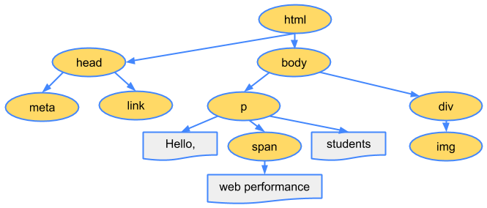
DOM

Slide 5
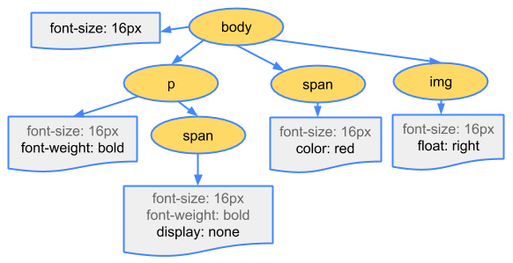
CSSOM

Slide 6
HTML
<!doctype html> <html> <head> <title>Title of page</title> <meta charset="UTF-8" /> <link href="style.css" type="text/css" /> <script src="script.js" type="text/javascript"></script> </head> <body> Document body </body> </html>

Slide 7
Text: Title
hn - Represent headings and subheadings.
<h1>Welcome to LeverX!</h1>
<h2>Introduction</h2>
<h3>Prologue</h3>
<h4>Level-4</h4>
<h5>Level-5</h5>
<h6>Level-6</h6>
Welcome to LeverX!
Introduction
Prologue
Level-4
Level-5
Level-6

Slide 8
Text: Paragraph
The p element represents a paragraph.
<p>The quick brown fox jumps over the lazy dog.</p>
The quick brown fox jumps over the lazy dog.

Slide 9
Text: Paragraph
<span> element is a generic inline container for phrasing content, which does not inherently represent anything. It can be used to group elements for styling purposes.
<p>The quick <span>brown</span> fox jumps over the lazy dog.</p>
The quick brown fox jumps over the lazy dog.

Slide 10
Text: List
UL - The ul element represents a list of items, where the order of the items is not important
<ul>
<li>Alice</li>
<li>Bob</li>
<li>Carol</li>
</ul>
Alice
Bob
Carol

Slide 11
Text: List
The OL element represents a list of items, where the items have been intentionally ordered, such that changing the order would change the meaning of the list.
<ol>
<li>This is the first list item</li>
<li>This is the second list item</li>
</ol>
This is the first list item
This is the second list item

Slide 12
Text: Highlighting
strong
b
i
em
blockquote
cite
q
sub
sup
del
ins
pre

Slide 13
Page parts
div
footer
header
article
aside
details
nav
summary
…

Slide 14

Table
<table border="1">
<tr>
<td>Google Chrome</td>
<td>78</td>
</tr>
<tr>
<td>Safari</td>
<td>35</td>
</tr>
</table>

Slide 15
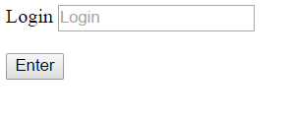
Form
<form action=“/logon" method="post">
<label for="login-field">Login</label>
<input type="text" name="login" placeholder= "Login">
<br>
<input type="submit" value="Enter">
</form>

Slide 16
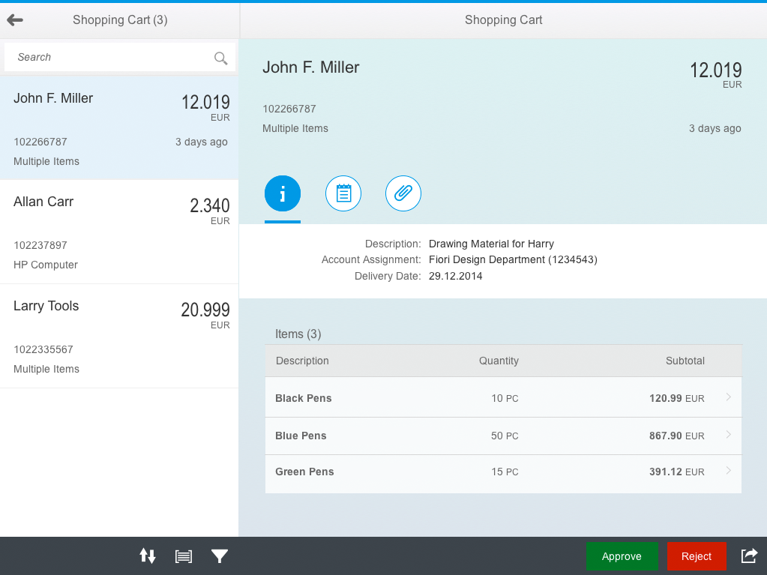
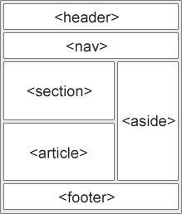
Page structure

Slide 17
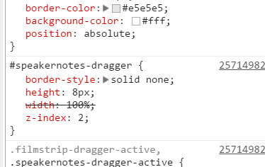
CSS
selector { prop1: value; prop2: value; }
selector2 { prop2: value; prop3: value;
}
selector { prop1: value; prop2: value; }
selector2 { prop2: value; prop3: value; }

Slide 18
CSS
tag style
inline styles
css file
js styles
<style>/* styles here */</style>
<p style=”/* styles here */”>LeverX</p>
<link href="file_name.css" rel="stylesheet" type="text/css" />
// your styles in file “file_name.css”
set or change styles in js functions

Slide 19
CSS: Selector
element
id
class
pseudo class
attribute
div
#link-list
.link-item
.link-item:hover
input[type=checkbox]

Slide 20
CSS: Position
“Document flow”
absolute
relative
static
fixed

Slide 21
CSS: Grid
float
display: inline-block
flexbox
/*new spec for css grid*/
float: left; float: right // *lifehack
display: inline-block //
display: flex;
flex-direction: row; /*row | row-reverse | column | column-reverse;*/
flex-wrap: nowrap; /*nowrap | wrap | wrap-reverse;*/
justify-content: space-between; /*flex-start | flex-end | center | space-between | space-around;*/
align-items: stretch; /*flex-start | flex-end | center | baseline | stretch;*/

Slide 22
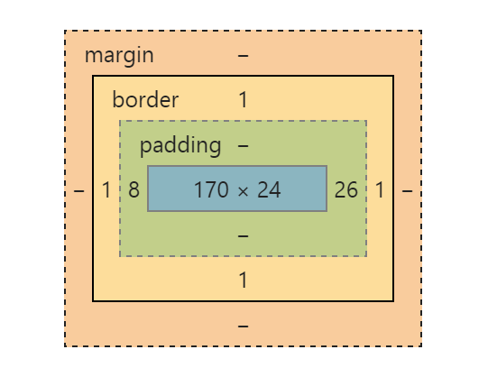
CSS: Indents
margin
padding
! box-sizing

Slide 23
CSS: Pseudo classes
active
checked
disabled
visited
last-child
nth-child
hover
focus
...

Slide 24
CSS: Pseudo elements
after
before
first-letter
first-line
selection

Slide 25
CSS: Priority
!important
style attribute
id
class
element

Slide 26
CSS: Inheritance
Not inheritable:
width
height
position
margin
padding
...

Slide 27
Useful links
https://developer.mozilla.org/en-US/docs/Web
http://www.w3schools.com/
http://www.w3.org/
http://caniuse.com/
http://htmlbook.ru/html
http://htmlbook.ru/css
https://gethtml.at/

Slide 28
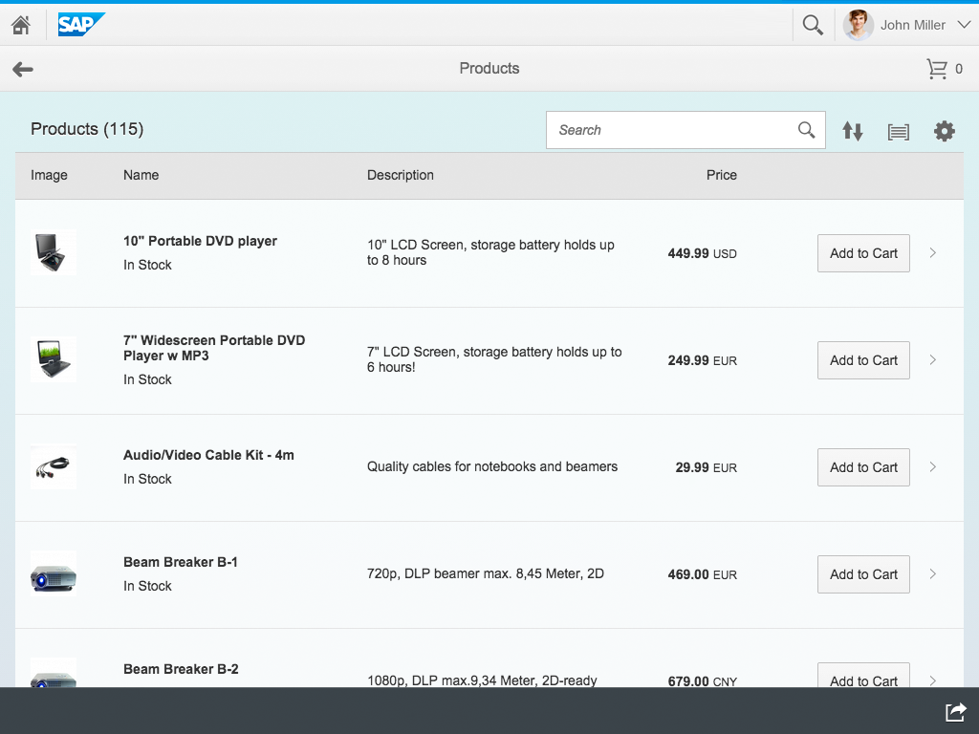
Homework
Create html structure and css styles in accordance with image. Send result to email iryna.levina@leverx.com with mark “Web Course. Homework” and your name.
Contacts:
email: iryna.levina@leverx.com
skype: lev.iryna

Slide 29
Time to practice!
Helping Companies Leverage Investments in SAP Solutions
Web&Mobile Team
Web&Mobile Team
November, 2015

